Slide 1
Medicine at Altitude
Wilderness and Expedition Medicine

Slide 2
Altitude Sickness
Altitude sickness is a spectrum of illness ranging from mild to severe AMS and the potential for life-threatening HACE and HAPE
HAPE – high altitude pulmonary oedema
HACE – high altitude cerebral oedema
AMS – acute mountain sickness

Slide 3
When does altitude sickness occur?
Can occur at altitudes from approx. 4000ft (Ben Nevis), but most common above 8000ft (Everest is 29,029ft).
Higher than 10,000 feet, 75% of people will get mild symptoms .
‘Climb high, sleep low’ is a good mantra for reducing likelihood of altitude sickness
Rapid ascent without sufficient acclimatisation is the strongest indicator of likelihood of developing altitude sickness

Slide 4
Risk factors for altitude sickness
Rate of ascent
Gender (most common in males aged 16-25years)
Absolute altitude gain
Previous history of AMS
Physical exertion
Pre-existing lung disease
Muscles/obesity.

Slide 5
Symptoms of AMS
Notes:
LLSS also used to include poor sleep but this was removed once it was acknowledged that almost everyone sleeps worse at altitude. Signs might include peripheral oedema, tachycardia, scattered crackles on auscultation, slightly raised basal temperature.

Slide 6
Managing AMS
If mild AMS you can take medication for symptom management – e.g. paracetamol, antiemetic.
If severe you can take acetazolamide (Diamox), oxygen and dexamethasone but must descend.
Diamox 250mg PO tds
Dexamethasone 4mg PO or IV qds
Caution with any prophylactic medications as Diamox if commonly taken prophylactically
Rest and allow time to recover.
Do not ascend.
If in doubt, descend.

Slide 7
Aetiology of AMS
Aetiology of all the altitude sicknesses are poorly understood.
AMS has been suggested to be an early form of HACE, caused by brain swelling and pressure symptoms, but the evidence doesn’t necessarily support this

Slide 8
High altitude pulmonary oedema
Movement of intravascular fluid to extravascular space which impairs gas exchange
Increased breathlessness and eventually SOB at rest
AMS is frequently but not always associated

Slide 9
Aetiology of HAPE
Also incompletely understood.
Exaggerated pulmonary hypertension in response to hypoxia from an abnormal hypoxic pulmonary vasoconstrictive response (HPVR) leads to capillary leak and mild alveolar haemorrhage.
Non-constricted vessels become hyperperfused with raised hydrostatic pressure which stretches the endothelial lining and leads to stress failure.
Hypoxia may also cause oedema through altered electrolyte balance.

Slide 10
Risk factors for HAPE
Men > women
Cold
Rapid ascent
Possibly viral infections or pneumonia
Previous episodes of HAPE
Structural cardiac or respiratory conditions (ASD, absent right pulmonary artery, CF) as increased pulmonary blood flow/exaggerated hypoxic pulmonary vascular reactivity)

Slide 11
S+S of HAPE
SOB on exertion progresses to SOB at rest
Cough, initially dry, becomes wet (note that a cough is very common at altitude)
Haemoptysis
Chest pain
Orthopnoea
Nausea
Insomnia
Headache
Dizziness
Confusion
Often AMS +/- HACE
Mild pyrexia
Tachypnoea
Tachycardia
Accentuated pulmonary 2nd sound
Right ventricular heave
Basal crepitations
→
Severe compromise
Cyanosis
Co-existing signs of HACE
Notes:
Difficult to distinguish from pneumonia, cough is common without HAPE.

Slide 12
Management of HAPE
DESCEND
High flow O2 by face mask (6-10l/min)
Hyperbaric chamber if available (Gamow bag)
Nifedipine (CCI) 20mg PO qds slow release preparation
Treat if co-existent HACE/AMS with dexamethasone
Alternatives if necessary: inhaled ß2 agonists, sildenafil, hydralazine, phentolamine.
Notes:
Hydralazine, anti-hypertensive vasodilator, acts on arterioles. Phentolamine is a competitive alpha-adrenergic antagonist, phentolamine binds to alpha-1 and alpha-2 receptors, resulting in a decrease in peripheral vascular resistance and vasodilatation.

Slide 13
HAPE on Everest

Slide 14
Gamow bag
Notes:
Creates an artificially higher partial pressure for the casualty. It can help with altitude sickness if temporarily unable to descend, but will not cure the altitude sickness. NB. It is difficult to care for the casualty once they are in the Gamow bag, it is very claustrophobic for the casualty, hard work to maintain the pressure for the rest of the team as needs continuous pumping of air.

Slide 15
Prevention of HAPE
Adequate acclimatisation and slow ascent (400-600m gain per night, with rest every 2-3 days)
Nifedipine 20mg PO tds slow release preparation
Early descent if symptoms
Diamox 250mg bd from 1 day before ascent (controversial as prophylaxis)
Dexamethasone 4mg qds may offer protection (even more controversial, if HACE develops you’re limited in what you can give, caution with climbers taking this as a performance enhancing drug, caution with adrenal crises after long-term use and then abrupt stop).

Slide 16
High altitude cerebral oedema

Slide 17
HACE
Rare but potentially fatal
Around 2-3% of people travelling above 5000m will be affected
Hypoxia causes swelling of the brain within the fixed volume of the cranium.
Normally develops after AMS and/or HAPE
HACE rarely occurs without HAPE
HACE can occur suddenly in well-acclimatised climbers at extreme altitudes, some without headaches

Slide 18
Aetiology of HACE
Also poorly understood
Increased cerebral blood flow at altitude
Generalised capillary leakage at altitude
Impaired cerebral autoregulation on acute exposure to altitude
Potential changes to the blood-brain-barrier due to altered neurotransmitter release at altitude (e.g. VEGF)
Risk factors are similar to AMS and HAPE

Slide 19
Symptoms Signs
Headache
Nausea
Hallucination
Disorientation
Confusion
Ataxia
Hypoxia
Unreasonable behaviour
Focal neurological deficits
Cranial nerve palsies (e.g. sixth)
Papilloedema and retinal haemorrhages
Confusion, stupor, coma
Pulmonary oedema may co-exist

Slide 20
Managing HACE
Immediate descent of 500m-1000m (may need stretcher carry/assistance if they are ataxic/SOB)
High flow oxygen by mask
Dexamethasone 8mg by mouth or injection then 4mg 4-hourly for several days, before reducing dose over 1 week
Gamow bag if necessary but consider airway risk
Evacuate
Do not re-ascend until completely better

Slide 21
Preventing HACE
Adequate acclimatisation and slow ascent
Early descent if symptoms
Same prophylaxis as with HAPE but same controversy

Slide 22
Q1
A 28-year old man develops nausea and a severe headache whilst trekking in Nepal. Within the next hour he becomes ataxic and confused. A diagnosis of high altitude cerebral oedema is suspected. Other than descent and oxygen, what is the most important treatment?
Acetazolamide
Dexamethasone
Nifedipine
Naproxen
Furosemide

Slide 23
Q1
A 28-year old man develops nausea and a severe headache whilst trekking in Nepal. Within the next hour he becomes ataxic and confused. A diagnosis of high altitude cerebral oedema is suspected. Other than descent and oxygen, what is the most important treatment?
Acetazolamide
Dexamethasone
Nifedipine
Naproxen
Furosemide

Slide 24
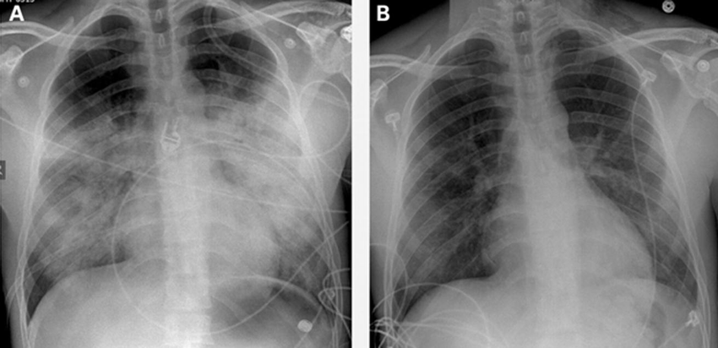
Q2
Which of the following drugs could be used to treat HAPE?
Sildenafil (Viagra)
Nifedipine
Diamox (acetazolamide)
Hydralazine
Dexamethasone
Notes:
Chris Imray - Chest radiograph showing high altitude pulmonary oedema. Progressive improvement was noted on chest radiographs after 3 h (A) and 5 h (B) of treatment with positive airway pressure, dexamethasone, nifedipine, and sildenafil in the emergency department before admission to intensive care.

Slide 25
Q2
Which of the following drugs could be used to treat HAPE?
Sildenafil (Viagra)
Nifedipine
Diamox (acetazolamide)
Hydralazine
Dexamethasone
Notes:
Chris Imray - Chest radiograph showing high altitude pulmonary oedema. Progressive improvement was noted on chest radiographs after 3 h (A) and 5 h (B) of treatment with positive airway pressure, dexamethasone, nifedipine, and sildenafil in the emergency department before admission to intensive care.

Slide 26
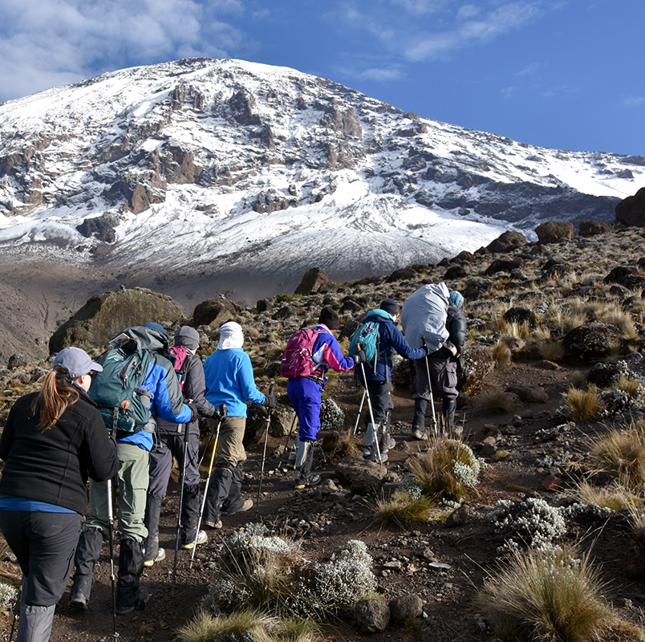
Q3
You are the expedition medic on a trek up Kilimanjaro. Last night, Joe did not join the rest of the group for dinner as he said he was tired after the day. The next morning as you are walking you notice he is struggling to keep up with the rest of the group despite previously having appeared really strong. After a 10 minute rest to have something to eat and drink, he appears out of breath. He insists he is fine and keeps going. 2 hours later you have arrived at your next camp and he appears worse.
Notes:
D - nil
R – responds but is confused, unsure of where they are, slightly slurred speech/ trouble word-finding.
C – no concern
A – airway is patent
B – RR is 26, O2 sats are 72% (if compared to rest of group other people have sats of 80%), crackles in lungs on auscultation. Cough with frothy sputum.
C – BP is 118/83, HR is 78, PCR > 2 seconds but due to cold, CCR < 2sec, blood on the floor and four more – no concerns.
D – glucose is 4.5, pupils normal
E – need to take a SAMPLE history

Slide 27
Q4
Which of the following is the correct regarding dexamethasone in treating HACE?
4mg PO or IV qds
8mg my mouth or injection followed by 4mg 4-hourly for several days
Dexamethasone does not treat HACE
2mg PO or IV qds

Slide 28
Q4
Which of the following is the correct regarding dexamethasone in treating HACE?
4mg PO or IV qds
8mg my mouth or injection followed by 4mg 4-hourly for several days
Dexamethasone does not treat HACE
2mg PO or IV qds

Slide 29
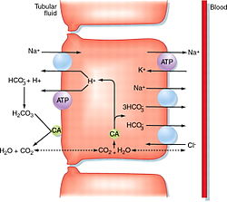
Q5
How does Diamox work to reduce AMS and improve acclimatisation?
What are some of the side-effects of taking Diamox (acetazolamide)?
Hint: it is a carbonic anhydrase inhibitor

Slide 30
Q5
How does Diamox work to reduce AMS and improve acclimatisation?
Diamox limits the secretion of H+ ions into the proximal convoluted tubule. This produces a metabolic acidosis which encourages an increased respiratory rate.
What are some of the side-effects of taking Diamox (acetazolamide)?
Paraesthesia, fatigue, drowsiness, depression, decreased libido, bitter or metallic taste, nausea, vomiting, abdominal cramps, diarrhoea, black faeces, polyuria, kidney stones, metabolic acidosis and electrolyte changes (hypokalaemia, hyponatremia).

Slide 31
Q6
You are at 12,000 ft on your way to summiting Cotopaxi in Ecuador. A member of your group has developed a cough and is short of breath on exertion. She is pyrexic (feverish) and tired. On auscultation she has basal crepitations (crackles). She has no GI symptoms or neurological symptoms. What is the most likely diagnosis?
AMS
HAPE
Pneumonia
HACE
Covid 19

Slide 32
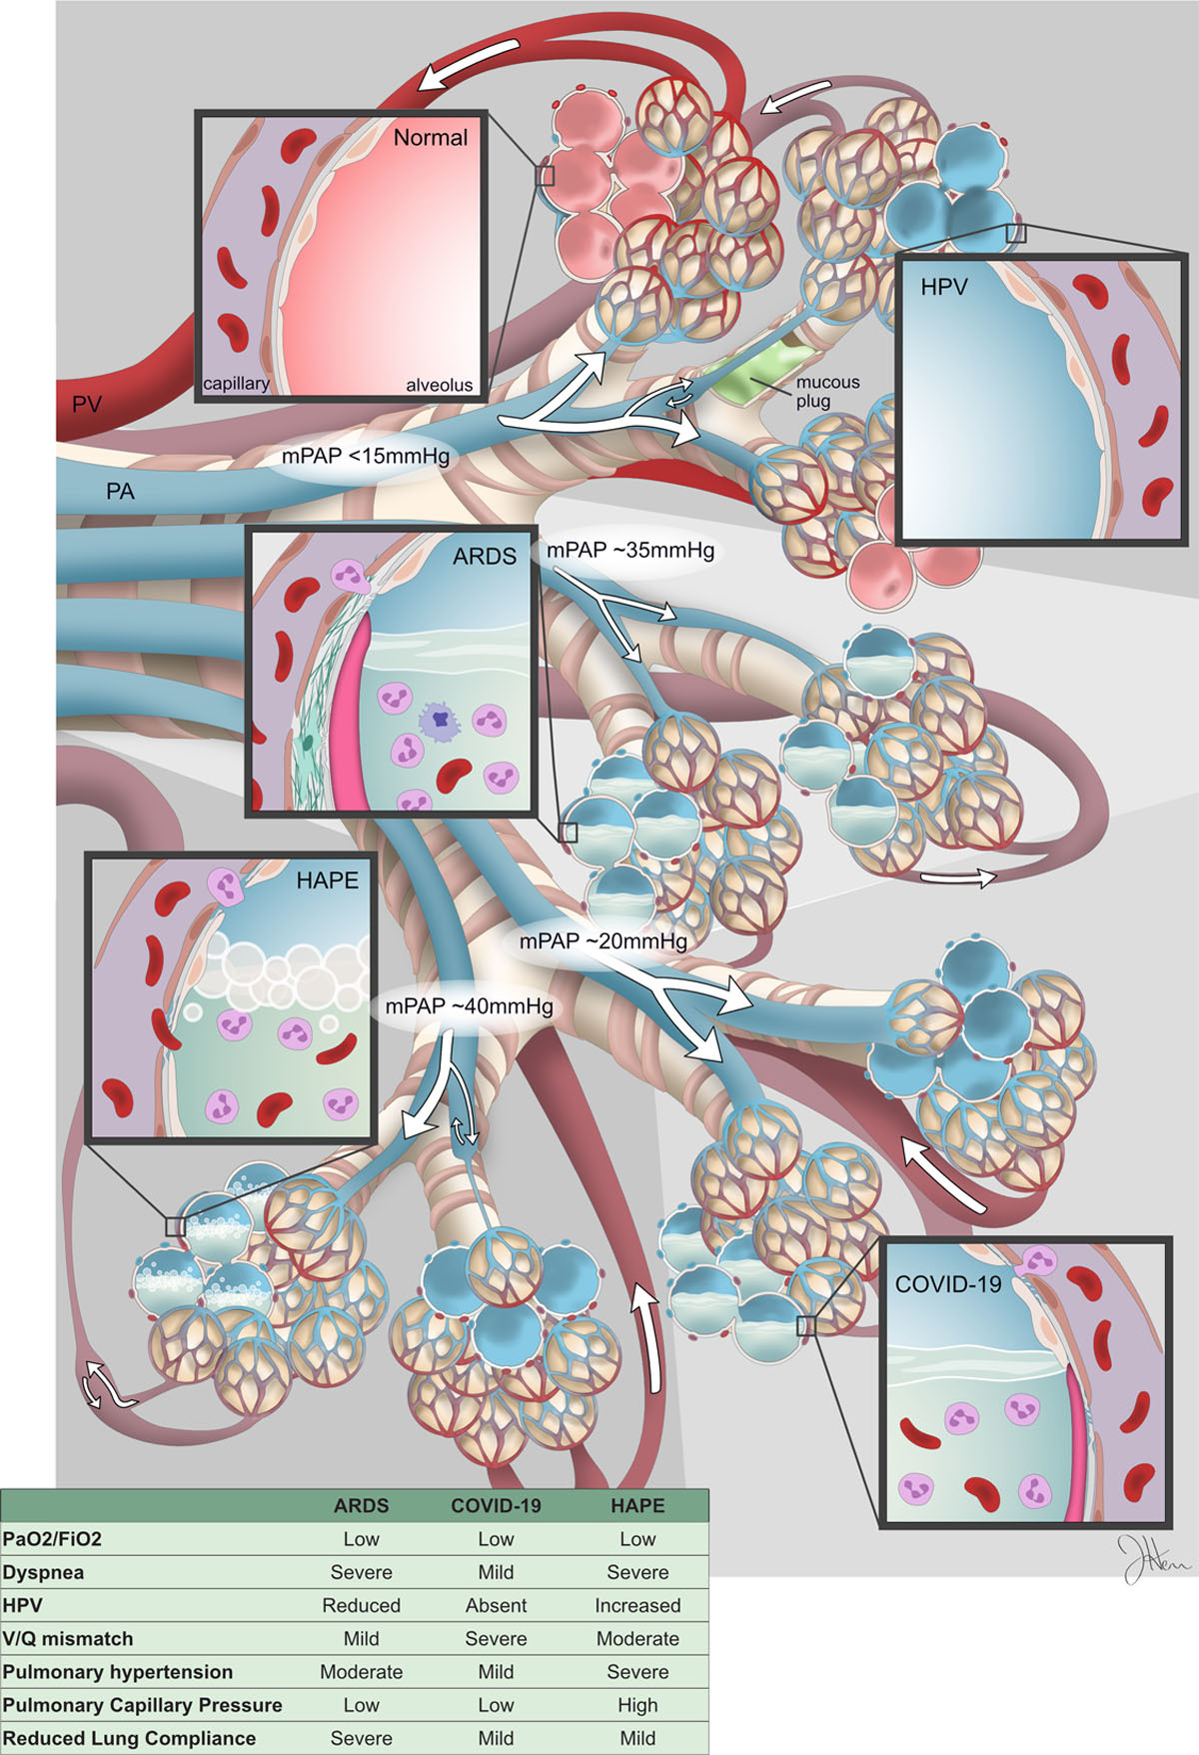
Q6
You are at 12,000 ft on your way to summiting Cotopaxi in Ecuador. A member of your group has developed a cough and is short of breath on exertion. She is pyrexic (feverish) and tired. On auscultation she has basal crepitations (crackles). She has no GI symptoms or neurological symptoms. What is the most likely diagnosis?
Notes:
Difficult to distinguish between HAPE, pneumonia, C19, if in doubt descend.
Hypoxic pulmonary vasoconstriction (HPV) is the pulmonary circulation’s homeostatic response to airway hypoxia in lung diseases, such as pneumonia. Acute respiratory distress syndrome (ARDS). Differentiating COVID-19 Pneumonia From Acute Respiratory Distress Syndrome and High Altitude Pulmonary Edema
Therapeutic Implications
Stephen L. Archer, Willard W. Sharp, and E. Kenneth Weir

