Slide 1
DRs [c]ABCDE

Slide 2
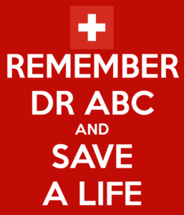
Drs (c)ABCDE
D – Danger
R – Response
S – Shout for help
C – Catastrophic haemorrhage (c-spine)
A – Airway
B – Breathing
C – Circulation
D – Disability
E – Exposure

Slide 3
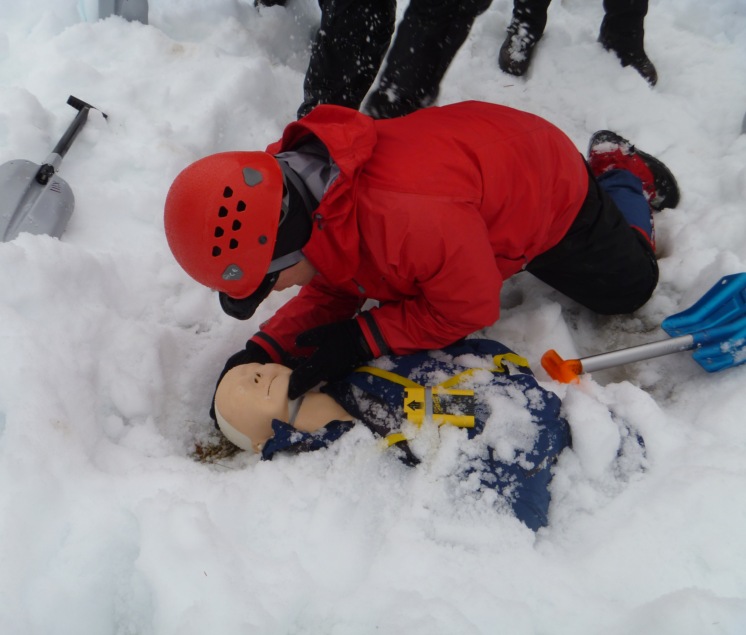
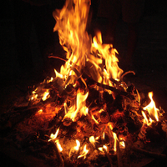
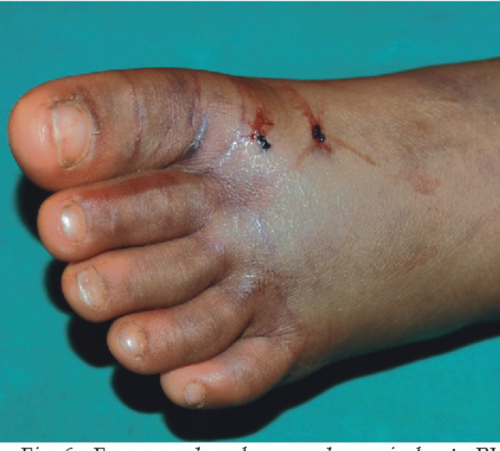
Danger
Make sure to check for any potential danger to yourself before approaching a casualty. e.g.
Avalanche
Fire
Toxins/chemicals (especially if 2 or more of unknown cause)
Animals
cold/heat
Vehicles

Slide 4
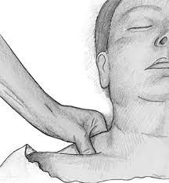
Response
Possible ways to check for response:
Calling out to them
Squeeze their trapezius muscle
Squeeze their fingernail
Jaw thrust
AVPU(C)

Slide 5
Call for help
(IF appropriate)

Slide 6
Catastrophic haemorrhage
‘Extreme bleeding likely to cause death in minutes’
Often described as ‘gushing’ or ‘pumping’ blood
This needs to be dealt with immediately

Slide 7
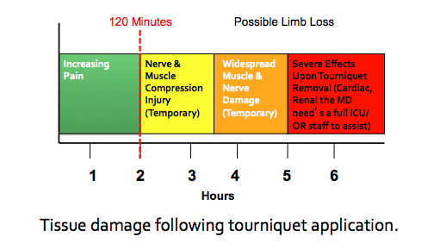
Catastrophic haemorrhage control
Pressure
Pack the wound
Haemostatic dressings
Pressure dressing (Olay or Israeli)
Tourniquet applied proximal to the wound
2nd tourniquet proximal to the 1st if one is insufficient
Notes:
Some medical kits will also carry Celox clotting dressings or granules. If you don’t have a tourniquet in your med kit, you can improvise one by wrapping bandages tightly above the wound and knotting a stick in, rotate the stick to tighten.

Slide 8
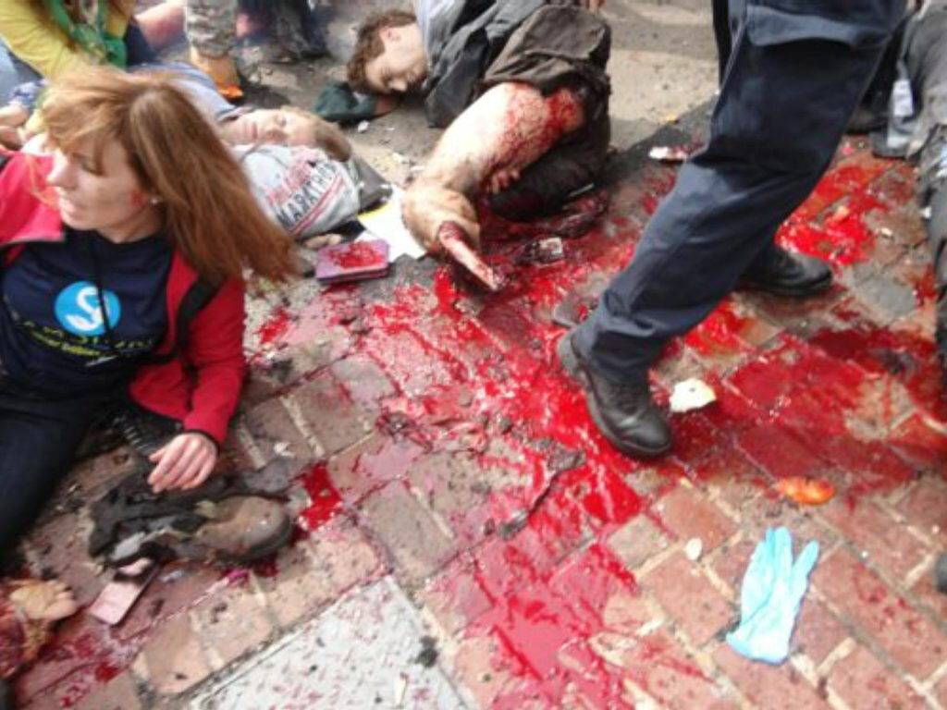
Catastrophic haemorrhage

Slide 9
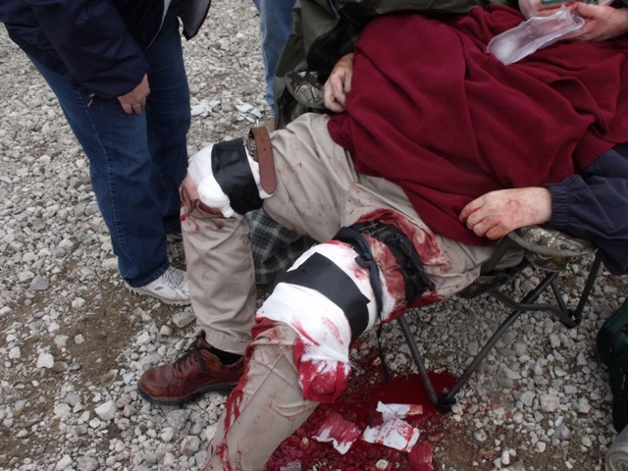

Slide 10
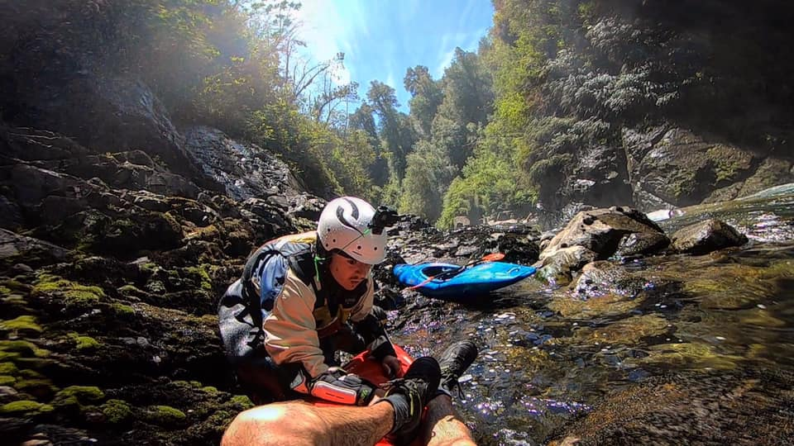
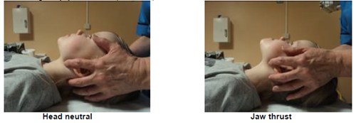
C-Spine
Keep the casualty’s head and neck still as seen in the bottom photo
Try not to cover their ears as it can be disorientating
Reassure the casualty
Ask them to keep still and say yes or no, not nod or shake their head
From this position you can also open their airway with a jaw thrust if necessary
Notes:
C-spine should be done alongside assessing A,B,C. Ideally in a group, one person can maintain the C-spine, whilst other people carry on assessing the casualty.
Picture - Bad landing, waterfall Chile. Fractured vertebra.

Slide 11
Suspicion of C-spine injury
Fall from height (normally considered high risk for C-spine injury if >3m)
If the casualty has a head injury
Road traffic accidents
Diving in shallow water
Sport specific injuries – e.g. rugby scrums
Casualty complaining of pain in neck or back
Notes:
Beware distracting injuries in C-spine – patient may not be worried about the slight pain in their neck if they’ve broken their leg.

Slide 12
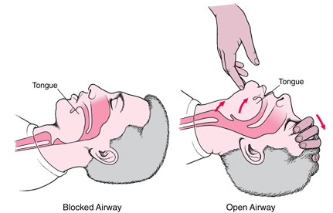
Airway
Check for anything blocking the airway
Don’t try to remove something from the airway if it means sticking your fingers in the casualty’s mouth, it could risk pushing the foreign object further or risk your fingers if the casualty bites down.
Tilting the chin back can help open up an airway
If a c-spine injury is suspected, use a jaw thrust instead

Slide 13
Breathing
‘Look’ – watch for the chest rising and falling
‘Listen’ – listen for breath sounds
‘Feel’ – hold your cheek above the casualty’s mouth to feel for any breathing (With covid-19 the advice for community first aiders is a bit different)
OBSERVATIONS:
Pulse oximeter – pulse and O2 saturation
Stethoscope – breath sounds
Assess for chest expansion – equal or unequal, shallow or normal
Respiratory rate

Slide 14
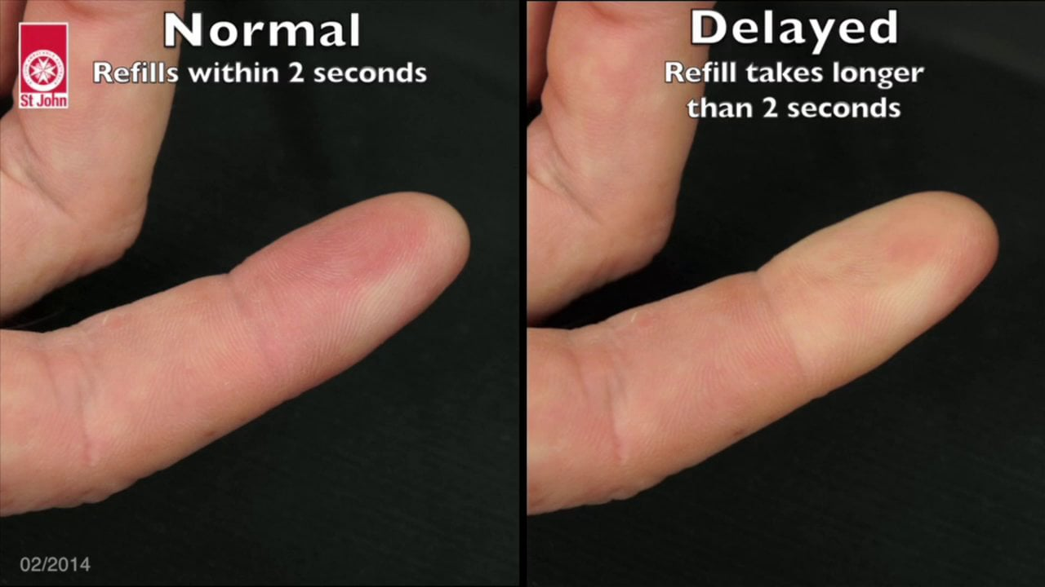
Circulation
Capillary Refill Time – press on a finger for 5s, count how many seconds it takes for the colour to return – should be <2 seconds
Compare amongst the group as cold can reduce peripheral circulation
Pulse rate, rhythm and quality
Feel temperature of peripheries
Look at colour of skin of hands
Check for any visible bleeding
Check chest, abdo, pelvis and long bones for any internal bleeding
Notes:
Low temperature can increase CRT.

Slide 15
Disability
Blood glucose
Pupils - size, equal and reactive to light
Assess consciousness level: Alert, Voice, Pain, Unresponsive (or confused) or GCS our of 15
Check neurology (squeeze hands, touch your nose, wiggle your toes)
Temperature
Notes:
A ‘blown’ pupil can be a late sign of a head injury

Slide 16
Everything else
Remove casualty’s clothes as necessary to do a secondary survey
Maintain their dignity
Ensure they are kept warm

